Slide 1

AUTOMATION
SAROWER AHMMED
Senior Automation Engineer
RABO BANK
PARK ave, Manhattan

Slide 2
Before automation or when start Automation
Need to ready manual test cases and data
Test need to be run manually at least one
Application must be
Ready and stable

Slide 3
What to Automate?
Front end/Browser end- like GUI/UI testing
Some backend/Database Automation Testing
Web service (SOAP & REST)
API testing- Rest API testing
Mobile Automation Testing
100% automation is irreverent

Slide 4
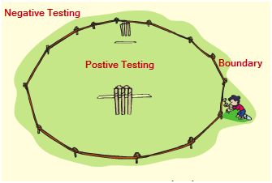

Automated Testing type
both test can be done by manually and Automated.

Slide 5
Benefits of Automated testing/ Why???
Faster
Reliable
Repeatable(Data Driven Testing)
Reusable
Reprogrammable

Slide 6
Main challenge in automation
Object/Element identification
Synchronization/ match speed
Maintenance of script
How to overcome those challenges?

Slide 7
Automation Framework
Framework is a standard way to help coding as it can handle-
Any future change like
New Feature add
New Function add
Data value change
Change old function or feature
So coding need to do some standard way as it can handle any change in application easily

Slide 8
Type of framework
Data driven framework – to handle data
Keyword driven framework- use key word to call different function
Hybrid framework- combination of upper both

Slide 9
Selenium framework
Page object model or Page factory concept – to handle object
Need all JAVA OOPS concept
Need TestNG, Maven knowledge
Need selenium knowledge

Slide 10
Automation Part cover
HTML- browser side language
Selenium Webdriver- to drive browser
Java – Coding other than selenium
Rrrrrrrrrrrrrrrrrrrrrrrrrr
Selenium Grid- cross platform testing & distributing test cases
TestNG- unit testing frame work
Junit- unit testing frame work
Maven- build checking tool
Jenkins- CI
GitHub- version control
Cucumber- BDD

Slide 11


Slide 12
Browser language
HTML
JavaScript
CSS
Selenium automation used browser HTML ,CSS & JavaScript

Slide 13
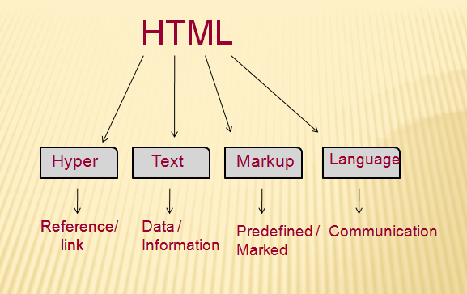

Slide 14
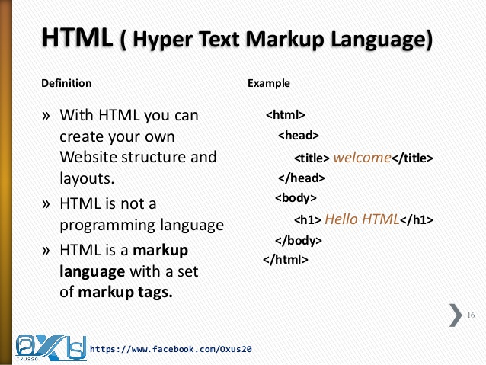

Slide 15
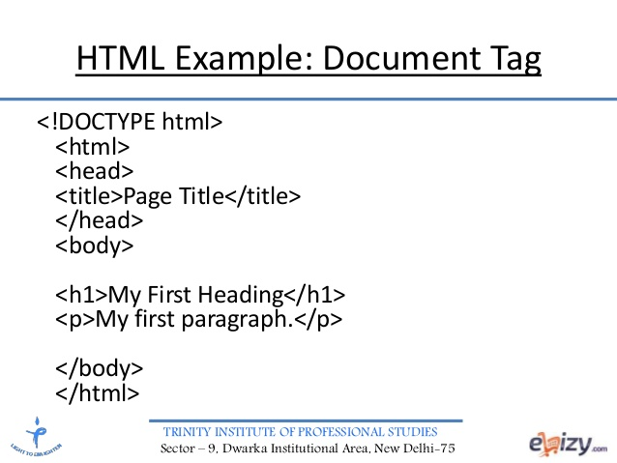

Slide 16
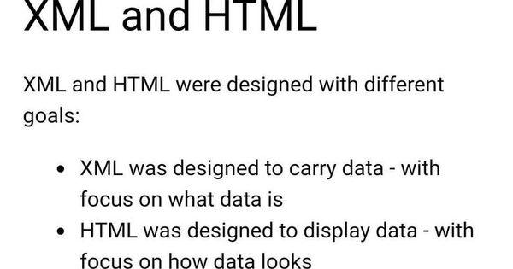
XML- web server language vs HTML- browser/frontend language
XML- user define tag /markup element VS HTML- predefine tag/markup tag

Slide 17
HANDS ON HTML

Slide 18
What is Locator?
Locator can be termed as an address that identifies a web element uniquely within the webpage.
Locators are the HTML properties of a web element (inside tag)
Which tells the Selenium about the identification of object or element in webpage

Slide 19

CSS Selector
Partial Link Text
DOM = deigns object Model
Whole HTML Page

Slide 20
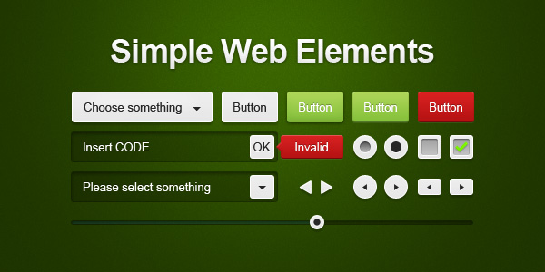
Automation Element or Object??
There is a diverse range of web elements:
Text box
Button
Drop Down menu
Hyperlink/link
Check Box
Radio Button

Slide 21
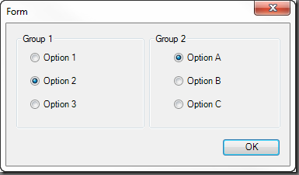
Radio button

Slide 22
What to do with selenium
Open browser
Close browser
All browser commands
Identify object by locator
Handle different object with Selenium methods

Slide 23

Eclipse
JAVA+ Selenium Code
Cucumber Code
TensNG/Junit code
Maven
SELENIUM
My company has Application
If its Web
Selenium can talk or interact with browser
Selenium can not handle Client application

Slide 24
Selenium Limitation
Can not handle client or desktop application (App not open by browser)
Can not generate report after test execution
How to generate report ??
TestNG Report
Cucumber report
3rd party API – Extend Report, ReportNG, Surefire….etc

Slide 25
HANDS ON LOCATOR

Slide 26
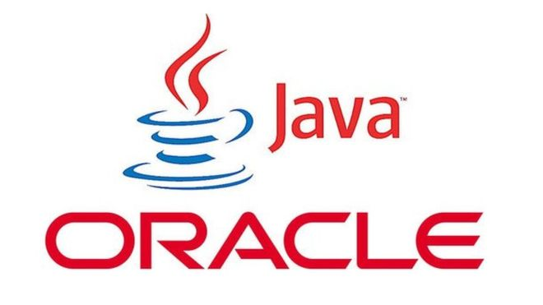

Sarower Ahmmed

Slide 27
JAVA project Structure
Project
Top most
packages
Collection of classes
Class
Blueprint of object
Class
Variable
Holder of Data
ALL JAVA Code
Methods
ALL Selenium CODE
Behavior of object

Slide 28
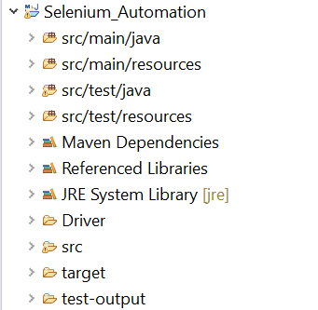
ECLIPSE JAVA project
Project Name
Maven Project Folder /Folder Structure of Maven
Library / JAR file
Additional Library File
Java JDK-JRE File
Browser Driver
Simple Java Project Folder
All Reports and Logs

Slide 29
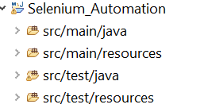
Why maven project has 4 folders ??
All Java supporting code here
All Java supporting code here
All Application related file here
All Application related file here
All test cases here
All test cases here
Test data & test supporting fie + Cucumber feature file here

Slide 30
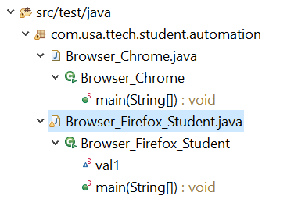
Inside folder
Package
.java file /class code
.class file/ after compiler
Method
VAriable

Slide 31
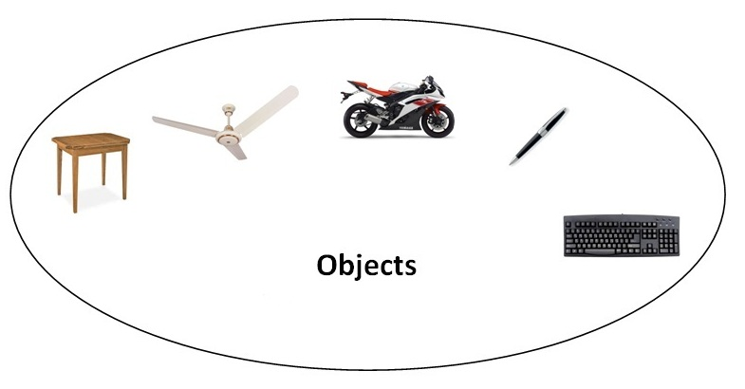
Object
Any entity that has state and behavior is known as an object. For example: chair, pen, table, keyboard, bike etc. It can be physical and logical.

Slide 32

Object
Object means a real word entity such as pen, chair, table etc.
Object-Oriented Programming is a methodology or paradigm to design a program using classes and objects.
It simplifies some concepts:
Object
Class
Inheritance
Polymorphism
Abstraction
Encapsulation
Interface
Constructor

Slide 33
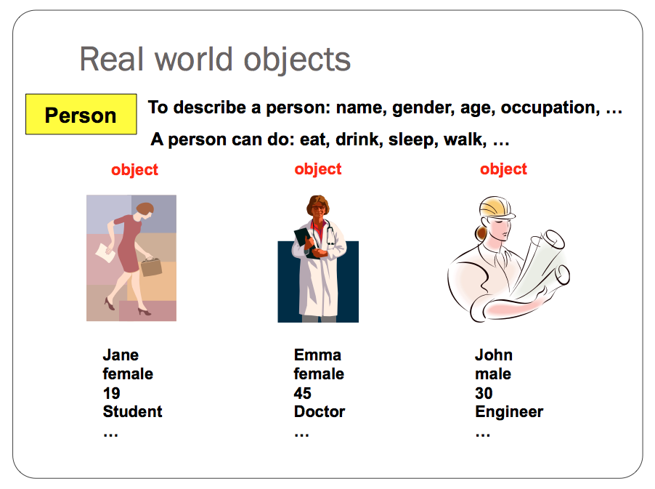

Slide 34
An object has three characteristics:
State: represents data (value) of an object.
Behavior: represents the behavior (functionality) of an object such as deposit, withdraw etc.
Identity: Object identity is typically implemented via a unique ID. The value of the ID is not visible to the external user. But, it is used internally by the JVM to identify each object uniquely.

Slide 35
Ways to initialize object
There are 3 ways to initialize object in java.
By variable / reference variable
By method
By constructor

Slide 36
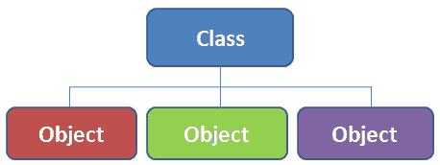
Class
Collection of objects is called class. It is a logical entity.
Its blue print of objects
It is a logical entity.
It can't be physical.

Slide 37
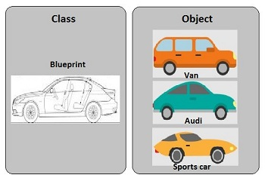

Slide 38
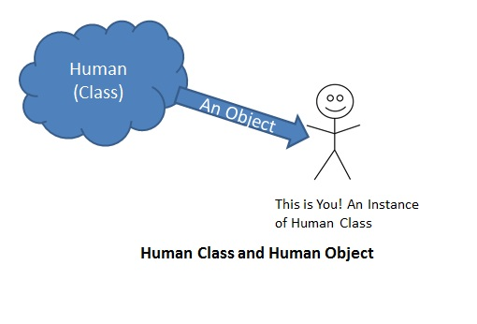

Slide 39
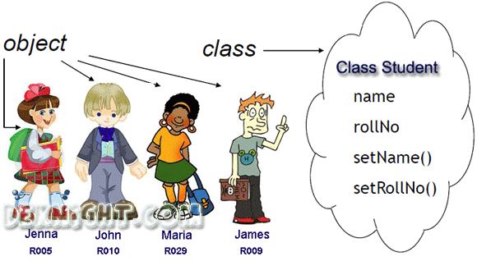

Slide 40
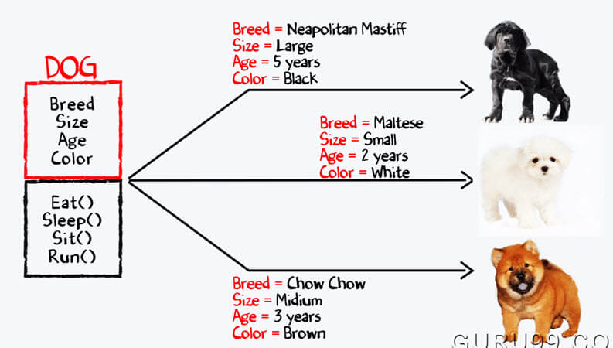

Slide 41

Object
Have some common criteria

Slide 42
Difference between object and class
OBJECT | CLASS
Object is an instance of a class | Class is a blueprint or template from which objects are created.
Object is a real world entity such as pen, laptop, mobile, bed, keyboard, mouse, chair etc. | Class is a group of similar objects.
Object is a physical entity. | Class is a logical entity.
Object is created through new keyword mainly e.g. Student boy=new Student(); | Class is declared using class keyword e.g. class Student{}
Object is created many times as per requirement. | Class is declared once.
Object allocates memory when it is created. | Class doesn't allocated memory when it is created.
There are many ways to create object in java such as new keyword, newInstance() method, clone() method, factory method and deserialization. | There is only one way to define class in java using class keyword.

Slide 43
What are the different ways to create an object in Java?
There are many ways to create an object in java. They are:
By new keyword
By newInstance() method
By clone() method
By deserialization
By factory method etc.

Slide 44
How to create object from class
Student girl= new student();
Student boy= new student();

Slide 45
Class Animal{
Animal dog = new Animal();
}
Class Vehicle{
Vehicle truck=new Vehicle();
}

Slide 46
Inheritance
Parent ➔ child
Genetic code transfer
Same :
Class A ➔extends➔ Class B ➔ extends ➔ Class C

Slide 47
//save by A.java
package pack;
public class A{
protected void msg(){System.out.println("Hello");}
}
//save by B.java
package mypack;
import pack.*;
class B extends A{
public static void main(String args[]){
B obj = new B();
obj.msg();
}
}
Output:Hello

Slide 48
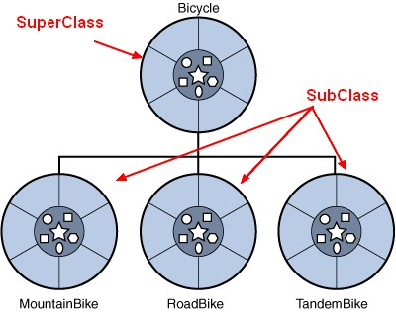
Class types
1st class/ main class/parent class- called SUPER class
Extended class/2nd class/child class- called SUB class

Slide 49
A class in Java can contain:
Variable
methods
constructors
nested class and
interface

Slide 50
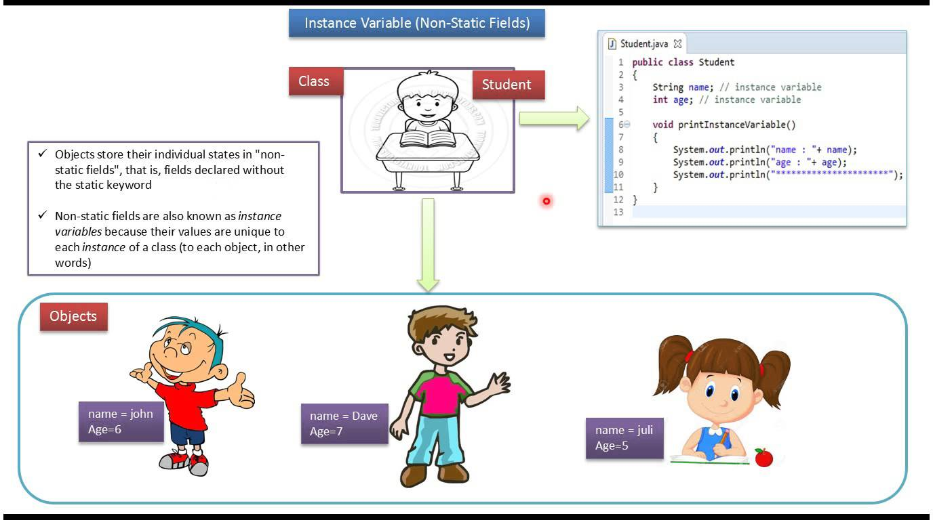

Slide 51
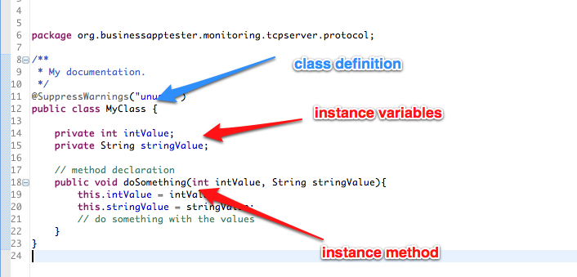

Slide 52
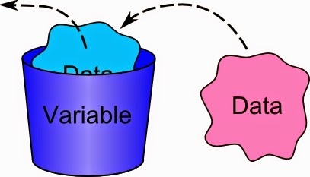
Variable
It’s a container to hold data.
An address or an index to some space of computer memory which hold data.
Called variable as it can be change.
Each variable has name and type according to data type it holds

Slide 53
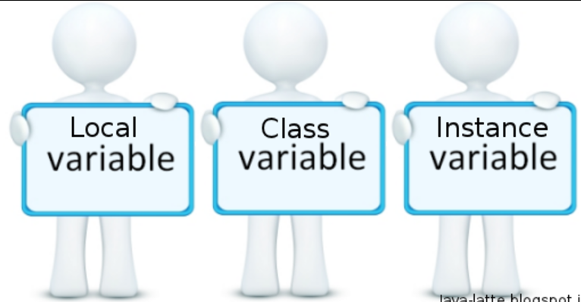
Type of variance during coding
3 kind of variable in java:
Another name of class variable is static variable

Slide 54
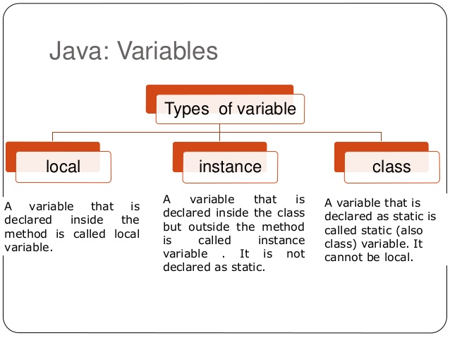

Slide 55
Static/ class level variable | Instance variable | Local variable
Inside class but outside methods | Inside class but outside methods | Inside methods
Use static word | No static | No static
Static method only handle it | Static or non-static methods | Static or non-static methods
Interface use it | Constructor use it | Only method use it

Slide 56
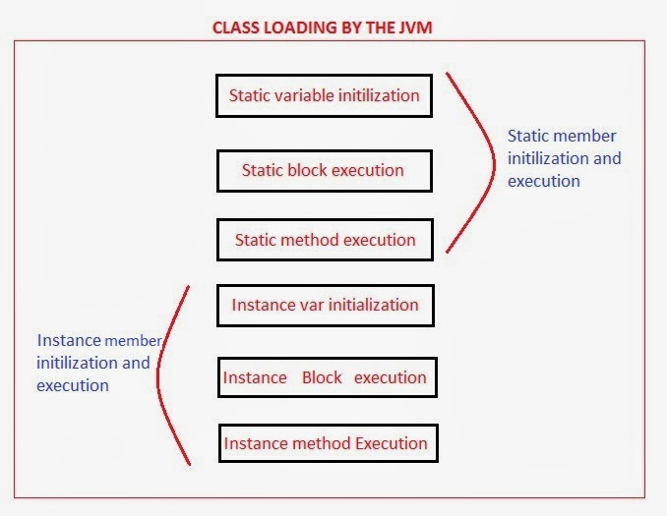

Slide 57
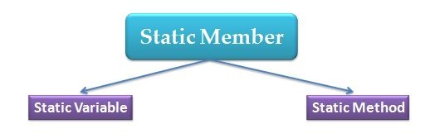
Static word in java
Static mean class level
It read after class by JVM
No need to create object to call it
So we call and use it directly without object
Static variable
Static method
Static interface

Slide 58
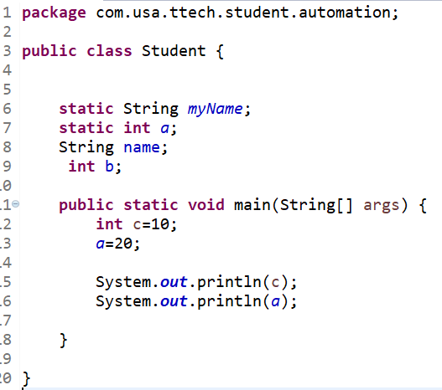
Static Variable
Instance Variable
Local Variable

Slide 59
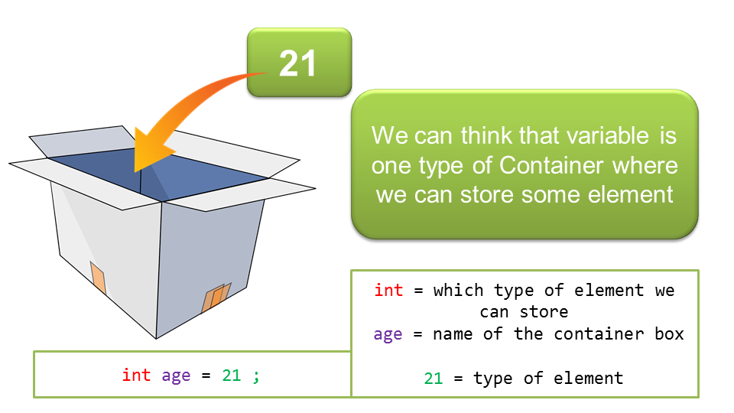

Slide 60
a
Int a
Name of container
Variable Declaration
10
Variable Initialization
Int a
= 10 ➔
Put value/date

Slide 61
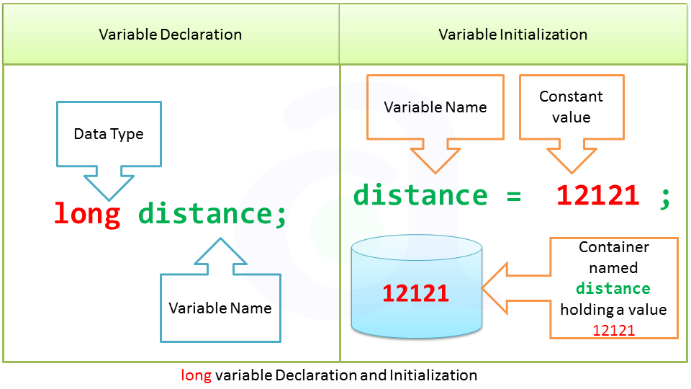

Slide 62
int a=10;
double b=10.25;
String username= “ sarower”;
String password= “ sarower123# ”;
boolean c = true ;
WRONG : if u mismatch data type
int a= “ sarower123# ”;
double b= true ;
String password= 10 ;==➔ wrong
String password= “10 ” ; ➔ Right
boolean c = 10.25;

Slide 63
Java Variable data type
Int can handle only number ,no fraction
Double can handle fraction
String can handle – character/number/special sign but
double coat “ StringName” must

Slide 64
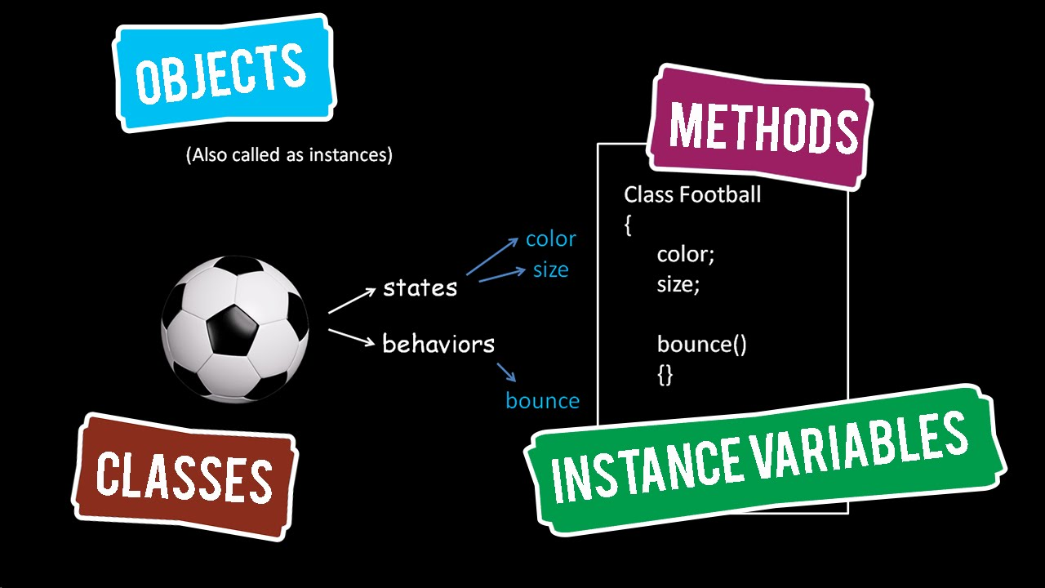
Methods

Slide 65
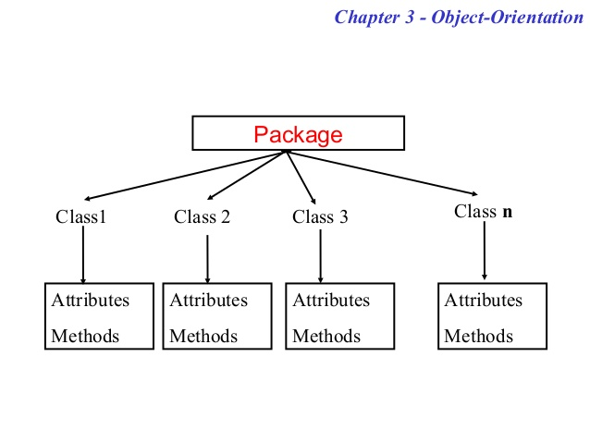

Slide 66
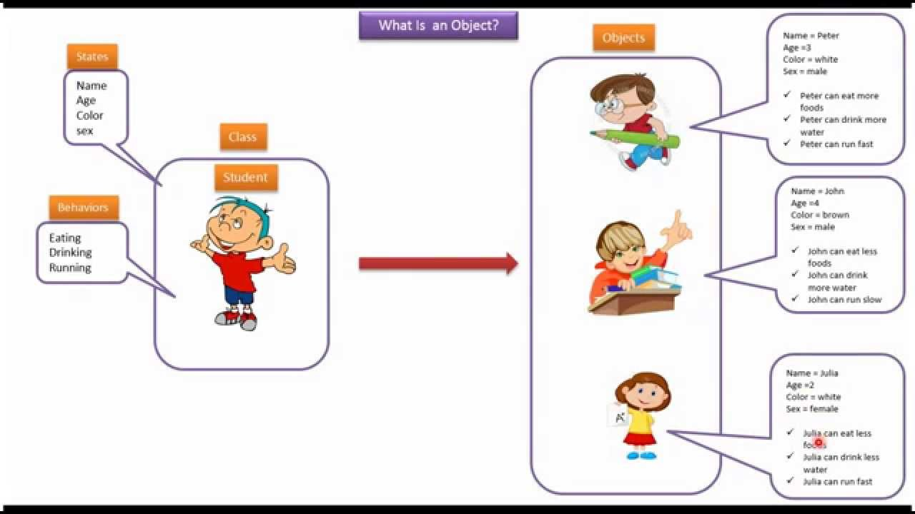

Slide 67
public Class Student{
Int age;
String name;
Public void running(){
age=10;
name= sarower;
Student boy =new student();
}
}

Slide 68
Types of Method | Why name | Static variable | Non -static/instance variable | class
Static Method | Static word used | Yes | No | Normal
No static Method | No Static | Yes | Yes | Normal
Void /return nothing | Void word | Yes | Yes | Normal
Non-Void/return something | No void | Yes | Yes | Normal
Main Methods | Static void main | Yes | No | JVM only run main method
Abstract method | No inside description | Nothing inside as no description | Nothing inside | Abstract class

Slide 69
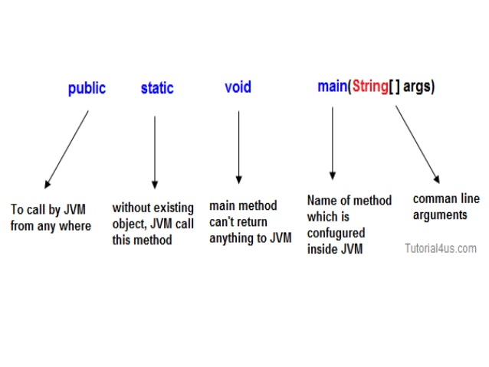

Slide 70
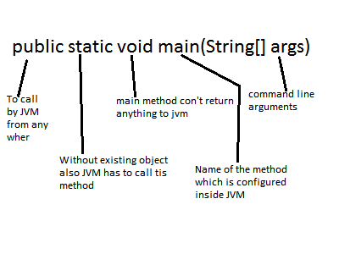

Slide 71
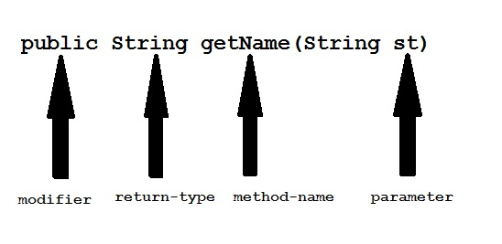

Slide 72
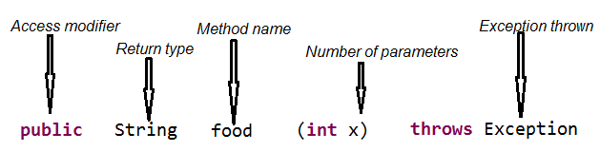

Slide 74
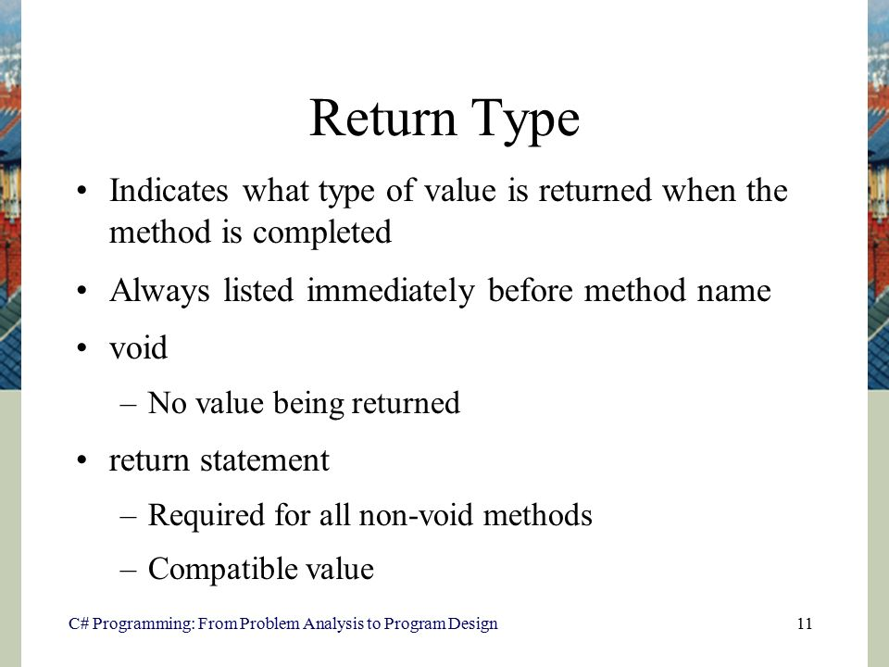

Slide 75
Abstract class in Java
Abstract mean incomplete
A class that is declared with abstract keyword, is known as abstract class in java. It can have abstract and non-abstract methods (method with body).
Before learning java abstract class, let's understand the abstraction in java first.

Slide 76
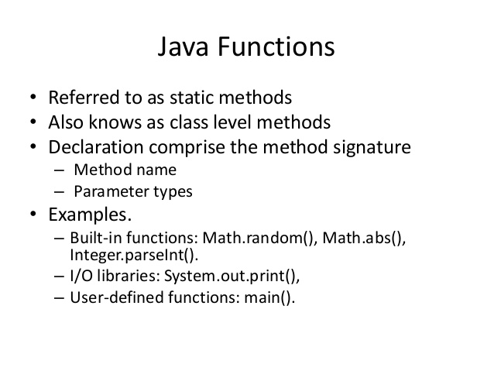

Slide 77
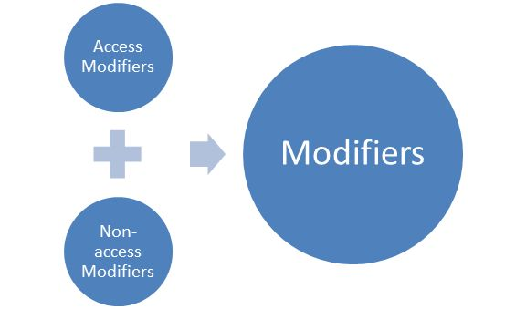

Slide 78
Type
Access Modifier
Non-Access Modifier
Public
Default
Private
protected
Final
Abstract
Static
Strictfp
Native
Synchronized
Transient

Slide 79
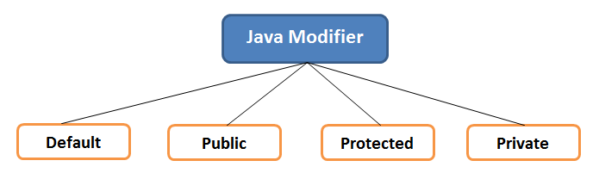

Slide 80
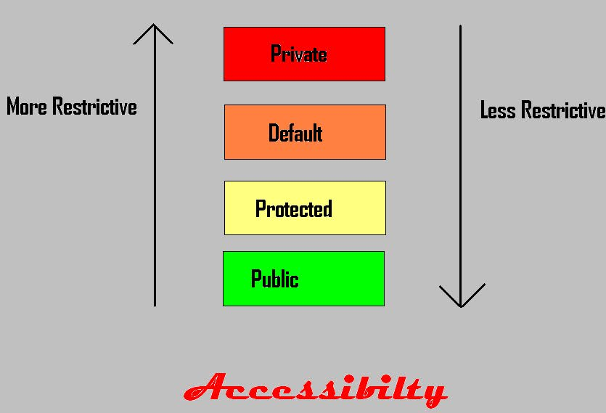

Slide 81
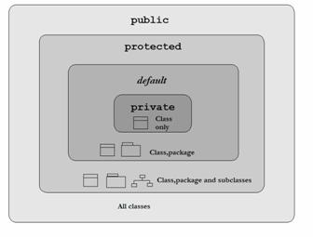

Slide 82
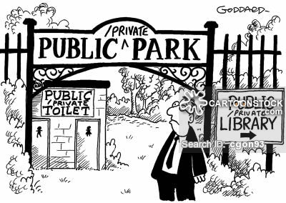

Slide 83
Package 1
Package 2
Class 1
Class 2
Other Class/Sub class 1
Subclass 2(class2 extends class1)
Public

Slide 84

Default / Natural property

Slide 85
Package 1
Package 2
Class 1
Class 2
Other Class/Sub class 1
Subclass 2(class2 extends class1)
default
The default modifier is more restrictive than protected

Slide 86


Slide 87
Package 1
Package 2
Class 1
Class 2
Other Class/Sub class 1
Subclass 2(class2 extends class1)
Protected

Slide 88


Slide 89
Package 1
Package 2
Class 1
Class 2
Other Class/Sub class 1
Subclass 2(class2 extends class1)
Private

Slide 90
Access Modifier | within class | within package | outside package by subclass only | outside package
Private | Y | N | N | N
Default | Y | Y | N | N
Protected | Y | Y | Y | N
Public | Y | Y | Y | Y

Slide 91
Example of public access modifier
//save by A.java
package pack;
public class A{
public void msg(){System.out.println("Hello");}
}
//save by B.java
package mypack;
import pack.*;
class B{
public static void main(String args[]){
A obj = new A();
obj.msg();
}
}
Output:Hello

Slide 92
In this example, we have created two packages pack and mypack. We are accessing the A class from outside its package, since A class is not public, so it cannot be accessed from outside the package.
Example of default access modifier
//save by A.java
package pack;
class A{
void msg(){System.out.println("Hello");}
}
//save by B.java
package mypack;
import pack.*;
class B{
public static void main(String args[]){
A obj = new A();//Compile Time Error
obj.msg();//Compile Time Error
}
}
In the above example, the scope of class A and its method msg() is default so it cannot be accessed from outside the package.

Slide 93
he protected access modifier is accessible within package and outside the package but through inheritance only(subclass).
//save by A.java
package pack;
public class A{
protected void msg(){System.out.println("Hello");}
}
//save by B.java
package mypack;
import pack.*;
class B extends A{
public static void main(String args[]){
B obj = new B();
obj.msg();
}
}
Output:Hello

Slide 94
The private access modifier is accessible only within class.
class A{
private int data=40;
private void msg(){System.out.println("Hello java");}
}
public class Simple{
public static void main(String args[]){
A obj=new A();
System.out.println(obj.data);//Compile Time Error
obj.msg();//Compile Time Error
}
}

Slide 95
Non Access Modifiers in Java
Final
Abstract
Static
Strictfp
Native
Synchronized
Transient

Slide 96
Final Non Access Modifiers
Final Class :
A Class when set to final cannot be extended by any other Class.
Example: A String Class in java.lang package
Final Method :
A Method when set to final cannot be overridden by any subclass.
Final Variable :
When a variable is set to final, its value cannot be changed. Final variables are like constants.
Example : public static final int i = 10;
Final modifiers are applicable to :
Class
Method
Instance Variable
Local Variable
Method arguments

Slide 97
Abstract Non Access Modifier
Keyword: abstract means incomplete
Abstract modifiers are applicable to:
Class
Method
Abstract Class:
An abstract Class can have abstract Methods. A Class can also be an abstract class without having any abstract Methods in it. If a Class has an abstract Method , the Class becomes an abstract Class.
Abstract Method :
Abstract Methods are those Methods which does not have a body but only a signature.
Example : public abstract void method();

Slide 98
The Static Modifier
The static keyword is used to create variables
Only one copy of the static variable exists regardless of the number of instances of the class.
Static variables are also known as class variables. Local variables cannot be declared static.

Slide 99
Static Methods
he static keyword in java is used for memory management mainly. We can apply java static keyword with variables, methods, blocks and nested class. The static keyword belongs to the class than instance of the class.
The static can be:
variable (also known as class variable)
method (also known as class method)
block
nested class

Slide 100
Java static method
If you apply static keyword with any method, it is known as static method.
A static method belongs to the class rather than object of a class.
A static method can be invoked without the need for creating an instance of a class.
static method can access static data member and can change the value of it.

Slide 101
class Student9{
int rollno;
String name;
static String college = "ITS";
static void change(){
college = "BBDIT";
}
Student9(int r, String n){
rollno = r;
name = n;
}
void display (){System.out.println(rollno+" "+name+" "+college);}
public static void main(String args[]){
Student9.change();
Student9 s1 = new Student9 (111,"Karan");
Student9 s2 = new Student9 (222,"Aryan");
Student9 s3 = new Student9 (333,"Sonoo");
s1.display();
s2.display();
s3.display();
}
}
Test it Now
Output:111 Karan BBDIT
222 Aryan BBDIT
333 Sonoo BBDIT

Slide 102
Another example of static method that performs normal calculation
//Program to get cube of a given number by static method
class Calculate{
static int cube(int x){
return x*x*x;
}
public static void main(String args[]){
int result=Calculate.cube(5);
System.out.println(result);
}
}
Test it Now
Output:125

Slide 103
Restrictions for static method
There are two main restrictions for the static method. They are:
The static method can not use non static data member or call non-static method directly. this and super cannot be used in static context.
class A{
int a=40;//non static
public static void main(String args[]){
System.out.println(a);
}
}
Test it Now
Output:Compile Time Error

Slide 104
Q) why java main method is static?
because object is not required to call static method if it were non-static method, jvm create object first then call main() method that will lead the problem of extra memory allocation
Since the main method is static Java virtual Machine can call it without creating any instance of a class which contains the main method.
4. Anything which is declared in class in Java comes under reference type and requires object to be created before using them but static method and static data are loaded into separate memory inside JVM called context which is created when a class is loaded. If main method is static than it will be loaded in JVM context and are available to execution

Slide 105
Why main method is public in Java
Any method or variable which is declared public in Java can be accessible from outside of that class. Since the main method is public in
Java, JVM can easily access and execute it.

Slide 106
Why the main method is void in Java Since the main method in Java is not supposed to return any value, it's made void which simply means main is not returning anything. Summary: 1. The main method must be declared public, static and void in Java otherwise, JVM will not able to run Java program.

Slide 107
Java static block
Is used to initialize the static data member.
It is executed before main method at the time of classloading.
Example of static block
class A2{
static{System.out.println("static block is invoked");}
public static void main(String args[]){
System.out.println("Hello main");
}
}
Test it Now
Output:static block is invoked Hello main

Slide 108
Can we execute a program without main() method?
Ans) Yes, one of the way is static block but in previous version of JDK not in JDK 1.7.
class A3{
static{
System.out.println("static block is invoked");
System.exit(0);
}
}
Test it Now
Output:static block is invoked (if not JDK7)
In JDK7 and above, output will be:
Output:Error: Main method not found in class A3, please define the main method as:
public static void main(String[] args)

Slide 109
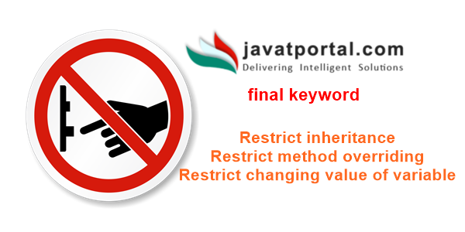

Slide 110
